Slide 1

Phishing website detection using machine learning

Slide 2
Agenda
Phishing threats and ML
Key Questions &
process
Model Recommendations
&
Deployment
Limitations & Future improvements
Feature selection
&
Model comparison

Slide 3
Phishing : An emerging cyber threat
75% of organizations have experience a form of phishing attack in 2020. Phishing also make up 22% of breaches identified in 2019, with this number predicted to increase as virtual work explodes in popularity
01
Phishing, the new threat
Phishing is simple, can be mass deployed and is very accessible to malicious actors. A study estimates that 156 million phishing emails are sent everyday within the United States
02
Why is Phishing popular?
03
$12 billion is estimated to be lost from companies through phishing in the past five years. The average cost of a data breach as of 2019 was $3.8 million
The impact to business
04
Training is not enough
Although organizations train employees to detect phishing, this is not foolproof and breaches will still occur

Slide 4
Using Machine Learning to optimize phishing detection
Machine learning models are flexible, can be retrained quickly if there are new features
Compared to humans, machine learning can quickly learn phishing patterns and predict with high accuracy
Machine learning can either stand alone or work together with humans to further improve detection performance
Why Machine Learning?
Notes:
Optimised phishing detection using Machine Learning

Slide 5
Key business questions
Model Maintenance
Model building
What model will provide the best performance in detecting phishing websites?
How can I maintain and deploy these models?

Slide 6
Model building process
Data gathering
Model tuning
Utilised a phishing dataset containing 30 features with > 11k records
Tune model variables and apply feature selection
Dataset Information
Source : UCI Machine Learning Phishing dataset
Notes : Data consists of only 1,0,-1 values as analysis was done by the authors in classifying it into these groups
Model building
Predict & Validate
Identify and build machine learning models
Use tuned models to predict unseen data and measure performance

Slide 7
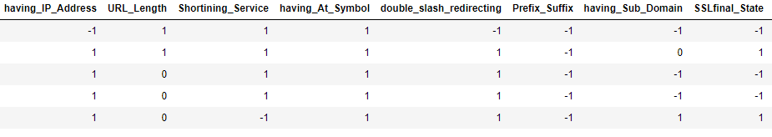
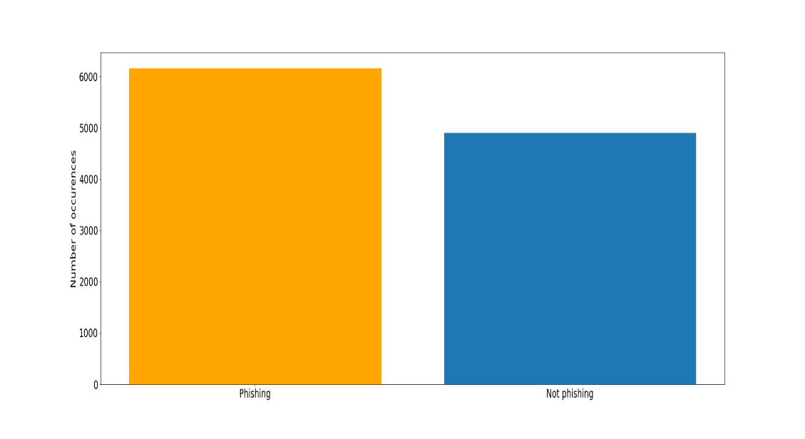
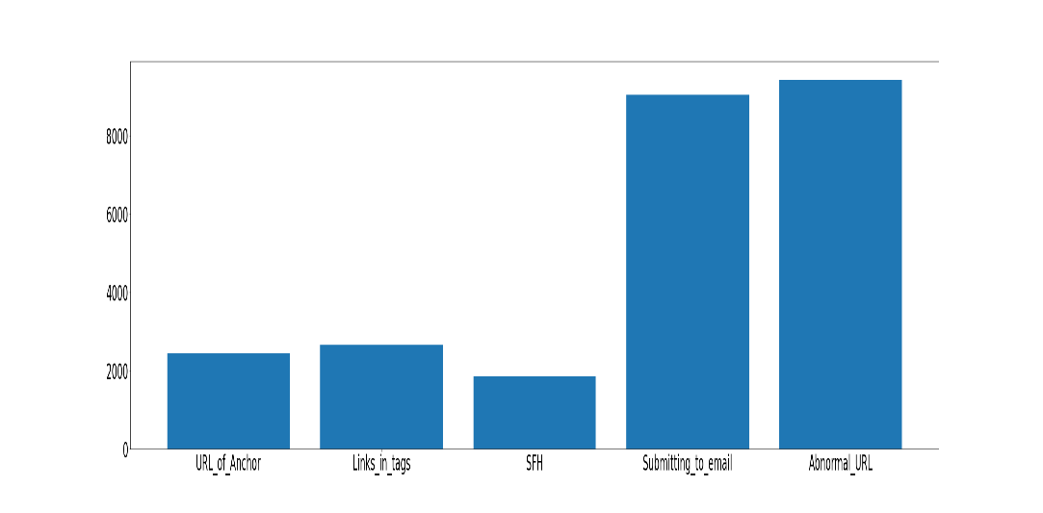
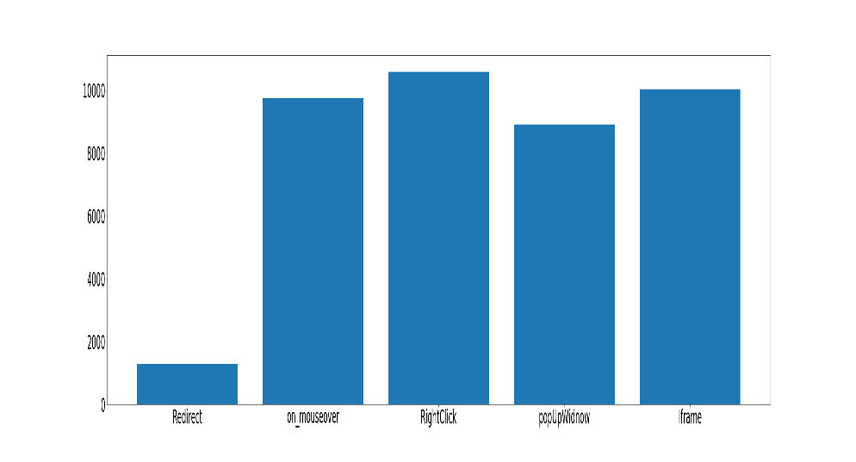
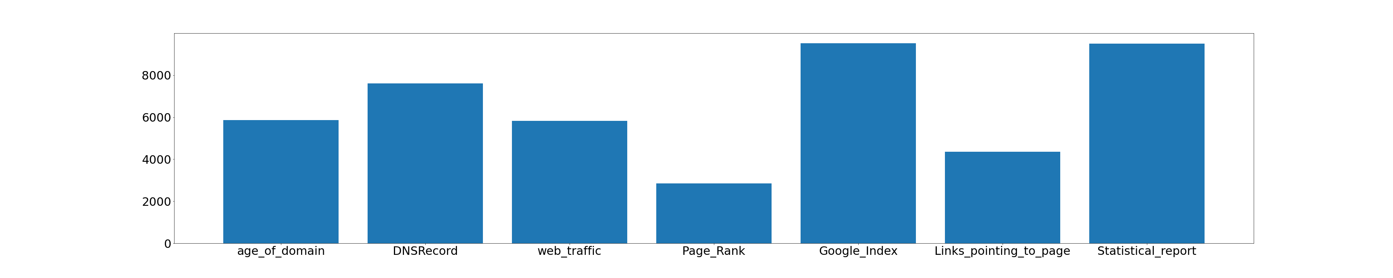
Sample data
Data exploration
Phishing vs Legitimate
Abnormal features
HTML & JS features
30 features
Feature groups
Domain features
Address bar based features
12
Abnormal based features
6
HTML, JS features
5
Domain features
7
Feature values
-1
0
1
Legitimate
Suspicious
Phishing

Slide 8
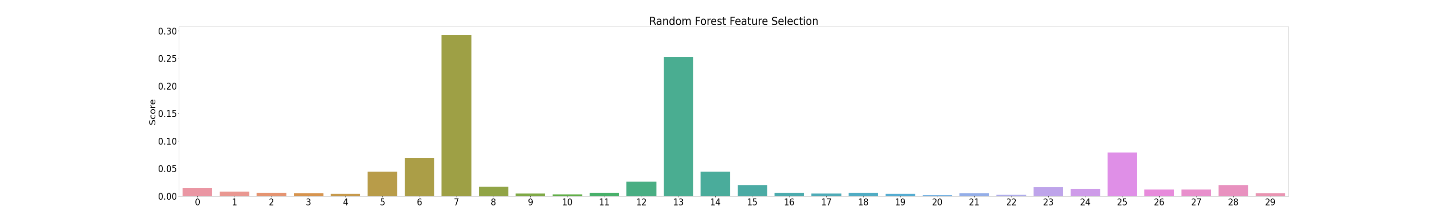
Feature Selection
Feature selection methods were applied to derive subsets of features based on their score of importance. Models will then be tested and compared between both the full set of features and the subsets
After feature selection, we have 3 subsets to use against the models:
Threshold : Score > 0.02
Threshold : Score > Mean score
Index | Feature | Score
5 | Prefixes and suffixes in URL | 0.04428
6 | having sub domains and multiple domains | 0.069491
7 | Existence of SSL in HTTP (HTTPS) | 0.292669
12 | Existence of the word ‘HTTPS’ in URL | 0.025973
13 | URL of the anchor | 0.252053
14 | Links in HTML, JS tags | 0.043884
25 | Web traffic : number of visitors | 0.079012
Index | Feature | Score
5 | Prefixes and suffixes in URL | 0.04428
6 | having sub domains and multiple domains | 0.069491
7 | Existence of SSL in HTTP (HTTPS) | 0.292669
13 | URL of the anchor | 0.252053
14 | Links in HTML, JS tags | 0.043884
25 | Web traffic : number of visitors | 0.079012
Full features

Slide 9
Model Selection & Setup
Logistic Regression
SVM
Naïve Bayes
Neural Nets
Cross Validation : 10 folds
Test cases:
Full features
Feature subset 1
Feature subset 2
Cross Validation : 10 folds
Test cases:
Full features
Feature subset 1
Feature subset 2
Cross Validation : 10 folds
Test cases:
Full features
Feature subset 1
Feature subset 2
Model type:
- Categorical Naïve Bayes
Cross Validation : None
Test cases:
Full features
Model type:
Single layer neural net
  30 inputs
Deep neural nets
  30 inputs
  Tuned through max 30 layers and 30 neurons

Slide 10
Model comparisons : Generalizing to unseen data
Model | Feature Engineering | Training scores | Testing scores
Logistic Regression | None | 0.930732 | 1.000000
Logistic Regression | Random Forest Feature Selection - 7 features | 0.920335 | 1.000000
Logistic Regresssion | Random Forest Feature Selection - 6 features | 0.918715 | 1.000000
SVM | None | 0.953807 | 0.947444
SVM | Random Forest Feature Selection - 7 features | 0.934369 | 0.929535
SVM | Random Forest Feature Selection - 6 features | 0.933494 | 0.930621
Naive Bayes | None | 0.930248 | 0.927907
Naive Bayes | Random Forest - 7 features | 0.922730 | 0.922027
Naive Bayes | Random Forest - 6 features | 0.917986 | 0.915422
ANN | None | 0.973940 | 0.953960
ANN-6 layers, Grid search | None | 0.989738 | 0.95560
All models have high testing scores, which means that they generalize well to unseen data
All models have higher and training scores with the full set of features. However, the gap is small, therefore we can be confident that most of the classification power is stored within the 6-7 features
The best model is a 6 layer neural net, followed by a single layer Neural net and then SVM using all features

Slide 11
Model comparison – Key metrics
Model | Feature Engineering | Accuracy | Recall | F1 score
Logistic Regression | None | 0.924089 | 0.943480 | 0.932158
Logistic Regression | Random Forest Feature Selection - 7 features | 0.914223 | 0.939514 | 0.923714
Logistic Regresssion | Random Forest Feature Selection - 6 features | 0.914497 | 0.941993 | 0.924125
SVM | None | 0.944368 | 0.964799 | 0.950427
SVM | Random Forest Feature Selection - 7 features | 0.926555 | 0.957858 | 0.935140
SVM | Random Forest Feature Selection - 6 features | 0.931214 | 0.947942 | 0.938405
Naive Bayes | None | 0.925185 | 0.948438 | 0.933398
Naive Bayes | Random Forest - 7 features | 0.919978 | 0.951909 | 0.929332
Naive Bayes | Random Forest - 6 features | 0.917786 | 0.948934 | 0.927326
ANN | None | 0.953960 | 0.961329 | 0.958478
ANN-6 layers, Grid search | None | 0.955604 | 0.966782 | 0.960118
All models have high accuracy, with the highest belonging to ANN – 6 layers
All models have higher recall than accuracy, which benefits our use case as we need to minimize false negatives.
The best model for this use case is a 6 layer neural net, followed by a single layer Neural net and then SVM using all features
Overall the best model is a six layer neural network with all features included
This indicates that the classification process for phishing website is complex and non-linear

Slide 12
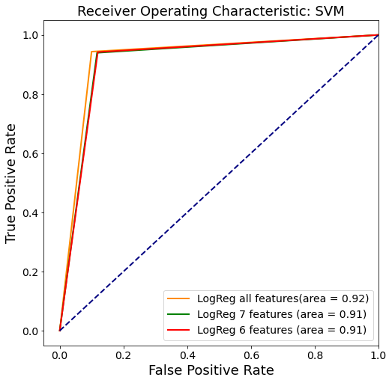
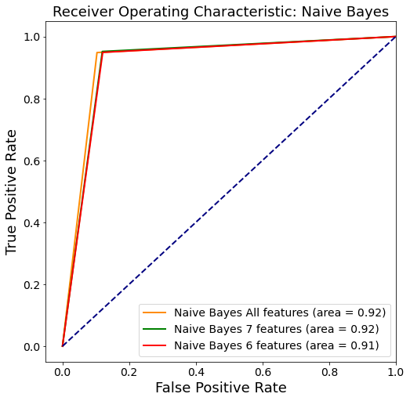
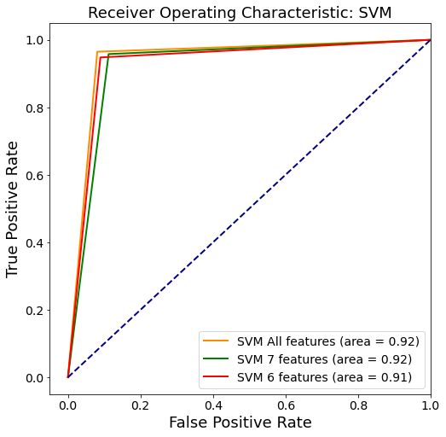
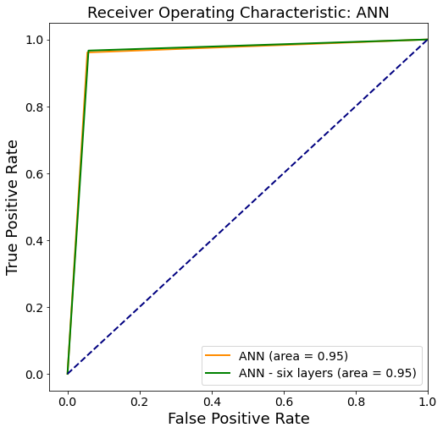
Model comparison – Predictive Performance

Slide 13
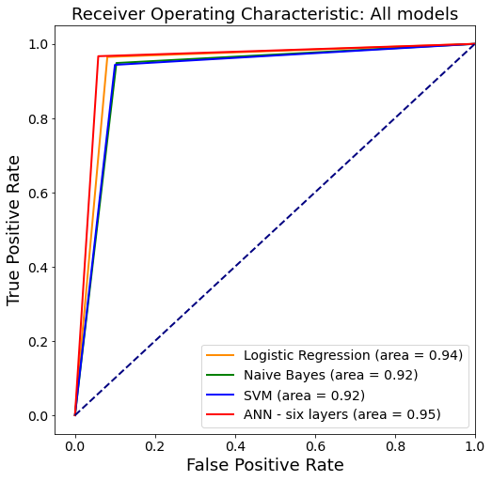
Model comparison – Predictive Performance
Overall, the six layer ANN has the highest predictive performance

Slide 14
Model recommendations, Deployment & Maintenance
What model will provide the best performance in detecting phishing websites?
The overall best model in terms of train, test, accuracy, recall and predictive performance for phishing website detection will be a deep neural network
In scenarios where the computing resource requirement is too high, consider using SVM and Logistic Regression
Does more features and more data matter?
When using neural nets, models will benefit from increased data
Perform feature selection to understand how much information each feature contributes. This will allow more efficient models that can run with less features
How do I deploy and maintain this model?
Tech infrastructure will be required to implement model, as well as feature transformation into the 1,0,-1 categories
Maintain the model by updating with new features, as cyber criminals will continually design new phishing methods
Take a specialized approach, what are the phishing threats that your organization is observing?

Slide 15
Limitations and future improvements
Model limitations
Lazy model, only predicts based on the feature transformation into the 1,0,-1 categories
Restrictive, model can only predict based on the 30 features provided to it
Only restricted to websites
Prone to adversarial attacks – cybercrminials learn the model and introduce small feature changes to cause incorrect classification
Future improvements
Ensemble classifiers
Apply a more adaptive approach, use NLP to analyse content and learn how cybercriminals write phishing emails
  Use computer vision to detect whether a website is phishing or not

Slide 16
Thank you

